Slide 1
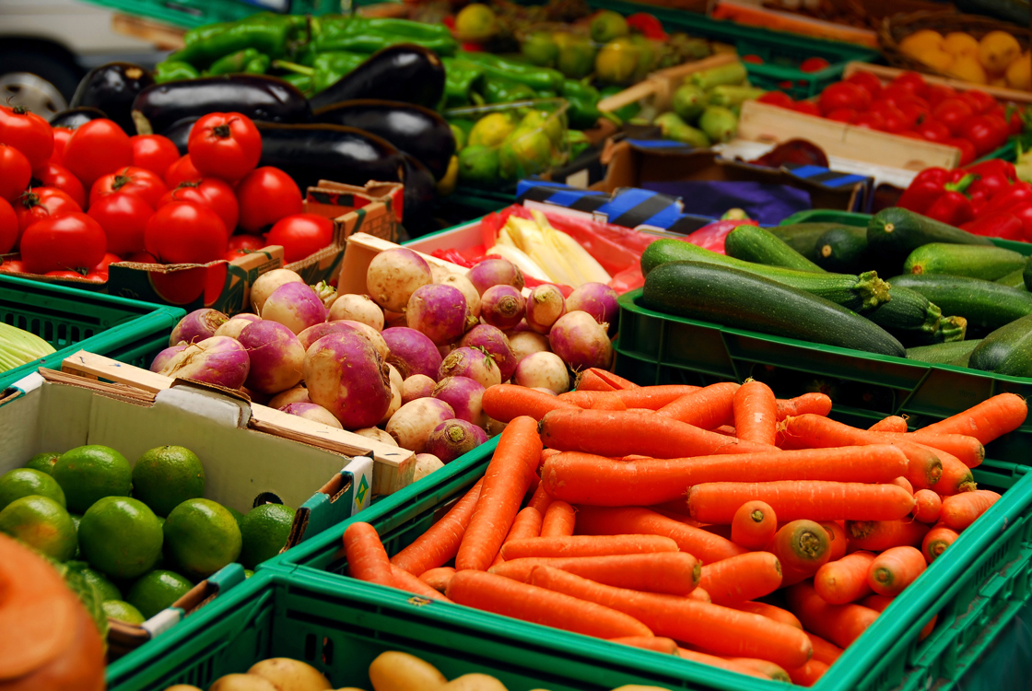
Vegetables

Slide 2
Types of Vegetables
Hundreds of different kinds of vegetables are available in the market-place. They are colorful, flavorful and nutritious. Besides being an important part of a meal, vegetables make great snacks. Most are low in calories and fat.
Vegetables are grouped according to how they grow and what part of the plant is eaten, there are 8 groups of vegetables.

Slide 3
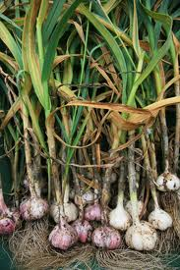
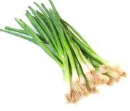
Bulb
Usually grow just below the surface of the ground and produce a fleshy, leafy shoot above ground.
Bulbs usually consist of layers or clustered segments.
Examples are onions, garlic, shallots, spring onions

Slide 4
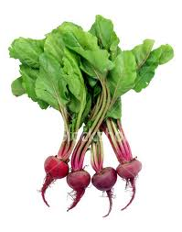
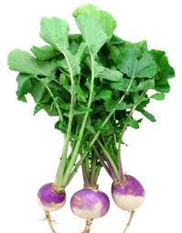
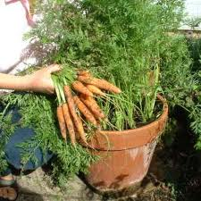
Root
Root vegetables are veggies where the root is actually the vegetable.
Roots should be hard and smooth, small roots are the most tender
Commonly known root vegetables are beet, carrots, and even turnips.

Slide 5
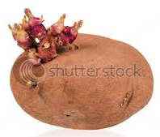
Tuber
Vegetables which grow underground on the root of a plant.
These vegetables tend to be higher in starch and calories.
Shriveled or sprouted tubers are old
Commonly known tubers are potatoes and yams.

Slide 6
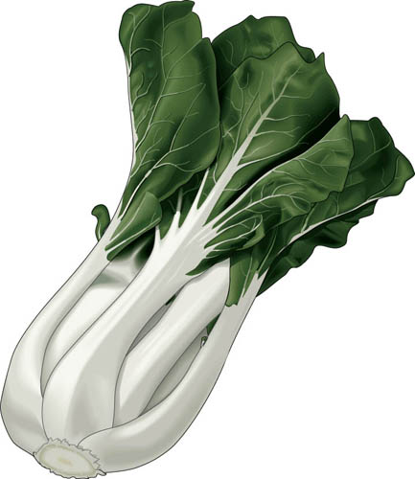
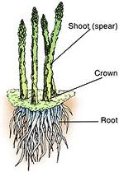
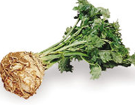
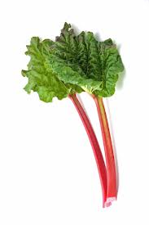
Stems
The edible stalks of plants, stems support the plant.
These vegetables have a high water content and are low in calories.
Best quality stems have crisp, straight stalks.
Common examples of stems are bok choy, asparagus, celery and rhubrarb.

Slide 7
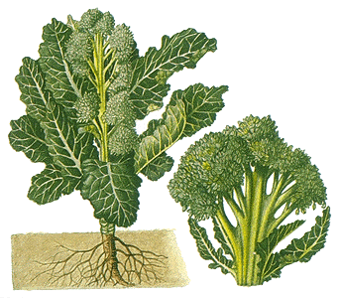
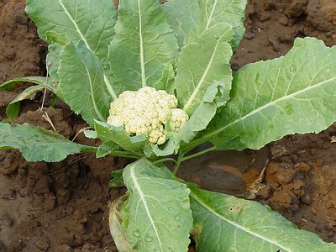
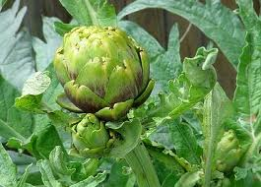
Flowers
Flowers are the plant’s blooms.
Best quality flowers are crisp and firm with closed clusters
Yellow buds on broccoli mean it’s old & strongly flavored
Cauliflower, artichoke, broccoli

Slide 8
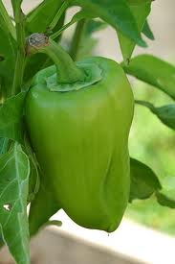
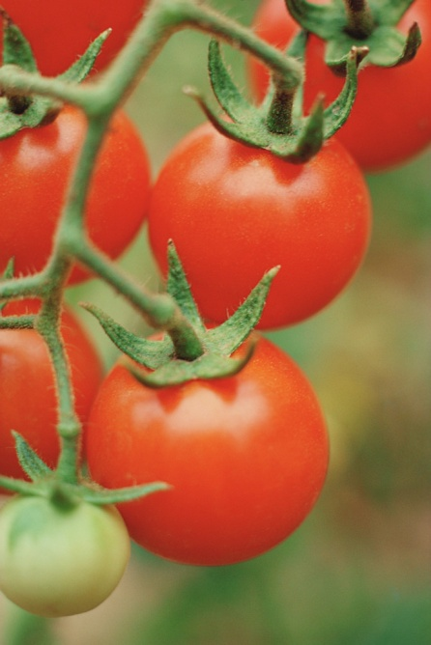
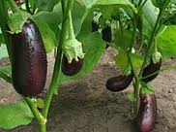
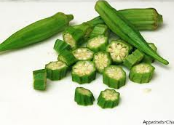
Fruits
Vegetable fruit are fleshy and contain seeds.
Fruit vegetables should be firm and heavy
Cucumber, eggplant, okra, pepper, squash (zucchini, pumpkin, acorn, yellow), tomatoes

Slide 9
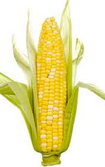
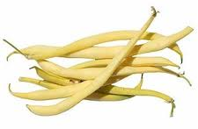
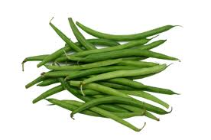
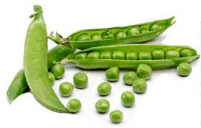
Seeds
These parts start the food growth process.
They can be high in starch and higher in calories.
They are best when freshly picked, small seeds have the best flavor
Peas, wax beans, green beans and corn are common seeds.

Slide 10
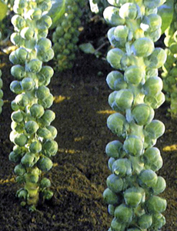
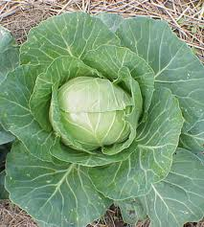
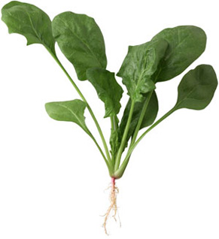
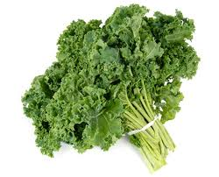
Leaves
The edible leaf of a plant.
Leaves with dark green are high in vitamins A and C, folic acid, calcium and iron.
Brussels sprouts, cabbage, lettuce, spinach, kale

