Slide 1
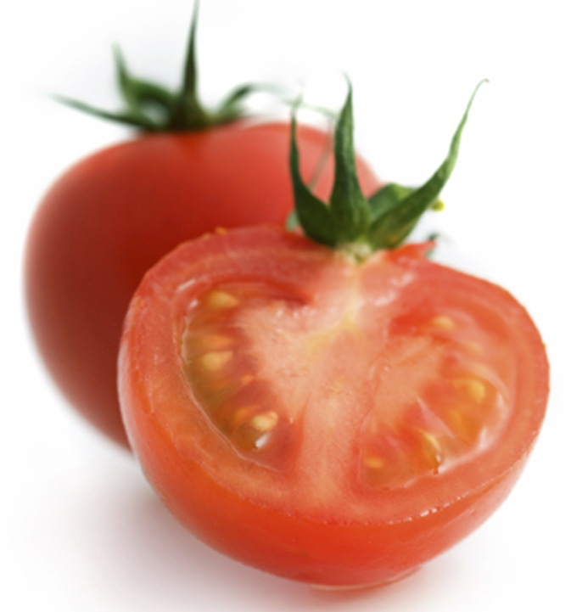
Is a tomato a fruit or a vegetable?
http://youtu.be/QHhnMFY1BdQ

Slide 2
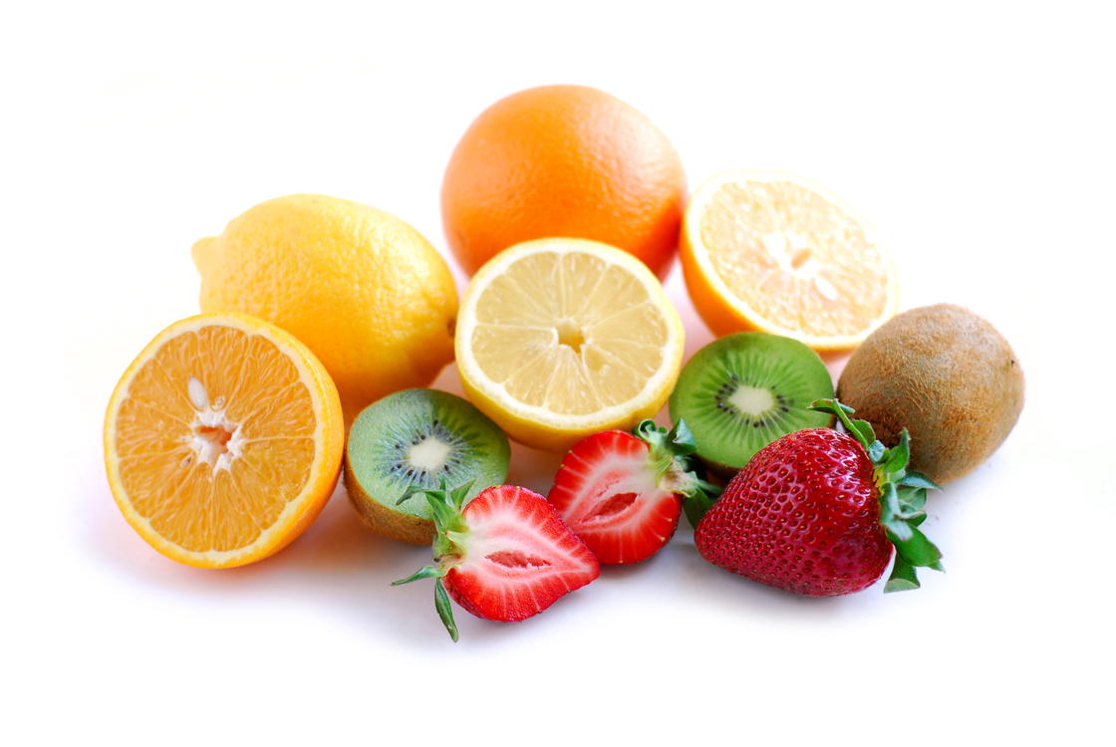
FRUIT CLASSIFICATIONS

Slide 3
Fruits
One way you can add flavor and variety to your diet without adding many calories is to eat plenty of fruits.
Most fruits have no fat and are high in vitamins, minerals and fiber.

Slide 4
Types of fruits
Most fruits are naturally sweet and are high in vitamin C, vitamin A and fiber.
A fruit is the part of a plant that holds the seeds. Fruits are categorized by certain characteristics that set them apart from each other. There are 6 types of fruits.
  Berries Melon
  Drupes (stone fruit) Citrus
  Pomes Tropical

Slide 5

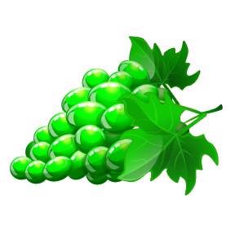

Berries
Berries are small juicy fruits with thin skins.
Examples: blackberries, cranberries, blueberries, red and black raspberries, and strawberries
Grape and currants also belong to this group
All are highly perishable

Slide 6

Drupes (stone Fruit)
Outer skin covering a soft fleshy fruit
Fruit surround a single, hard seed called a pit or stone
Examples: Cherries, apricots, nectarines, peaches, and plums

Slide 7
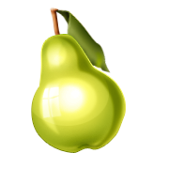

Pomes
Central seed containing core surrounded by a thick layer of flesh
Several small seeds
Examples: apples pears, quince

Slide 8


Melon
Large, juicy fruits with thick rinds and many seeds
In the gourd family
Examples: cantaloupe, honeydew, and watermelon

Slide 9
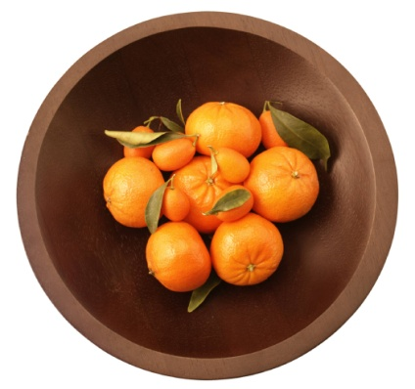



Citrus
Thick outer rind
Thin membrane spate the flesh into segments
Examples: oranges, tangerines, tangelos, grapefruits, kumquats, lemons and limes

Slide 10
Tropical
Grown in warm climates and considered exotic
Commonly available in USA are: avocados, figs, dates, guava, mangos, papayas, persimmons, pineapples, kiwifruit and bananas

