Slide 1
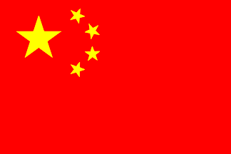
CHINA

Slide 2
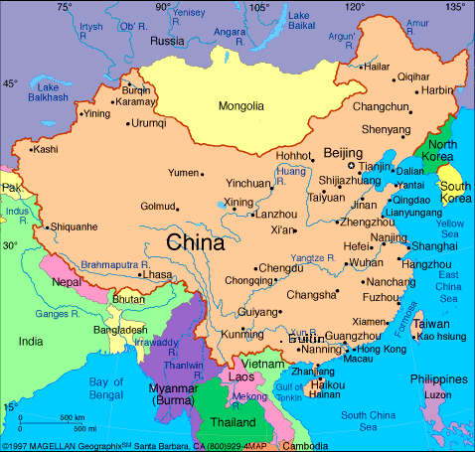
Geography
Third largest country
Boarded by Pacific Ocean and South China Sea
West and southwest are too mountainous and barren to live or grow crops
Most live in Eastern China

Slide 3
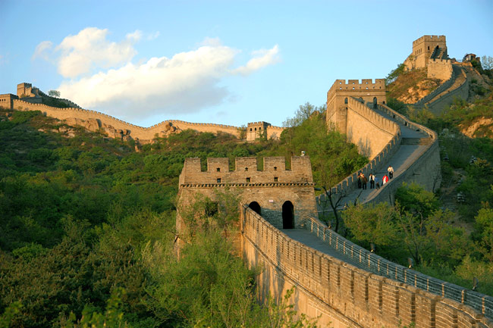
Culture
Largest population in world
Inventions or Achievements
  Paper
  Gunpowder
  Magnetic compass
  Great Wall (4,000 miles)
  Art and Literature

Slide 4
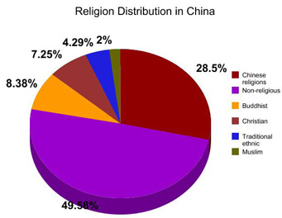
The People’s Republic of China
Chinese Communists gained control of government in 1949
In pre-Communist China many religions were practiced.
Today people don’t openly practice religion

Slide 5
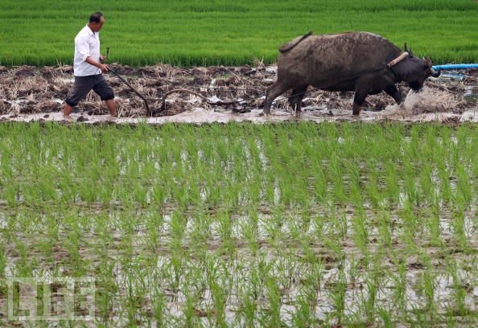
Agriculture
Most of China’s people are farmers working small family farms or on large government owned farms.
Rice is China’s #1 crop
Raise pigs, chickens, geese and ducks because they are small.

Slide 6
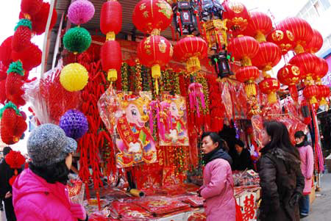
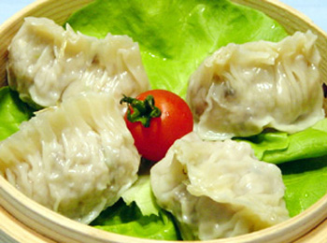
Spring Festival
Recognizes the new year
12 year Chinese zodiac cycle, each year named after a different animal
Celebrated by a dinner of festive foods including candied fruit and dumplings.

Slide 7
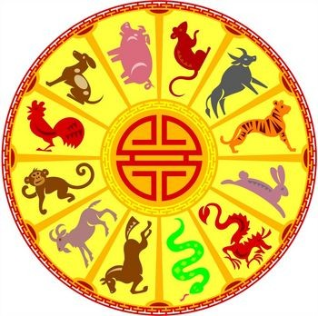
Chinese Zodiac Signs
Each person is assigned an animal based on the year they were born.
They believe that a person's life is influenced by their animal sign.
Certain the zodiac signs get along better than others.
1997 – Ox
  Hard working and steady
1998-Tiger
  Brave, competitive, unpredictable
1999-Rabit
  creativity, compassion, and sensitivity
2013 – Snake
  Intelligence, gracefulness

Slide 8
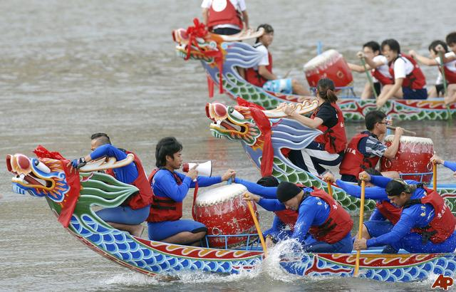
Dragon Boat Festival
Mid-summer
People used to throw rice cakes into river to appease mythical dragon
Now they hold boat races and eat rice cakes wrapped in bamboo

Slide 9
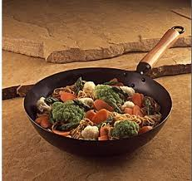
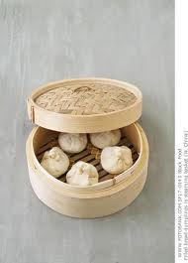
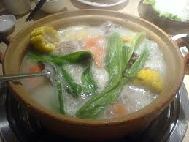
Chinese Cuisine
Meals include large amounts of rice and vegetables with small amounts of meat.
They stir-fry, steam or simmer. Making their dishes low in fat
Spend more time preparing to cook

Slide 10
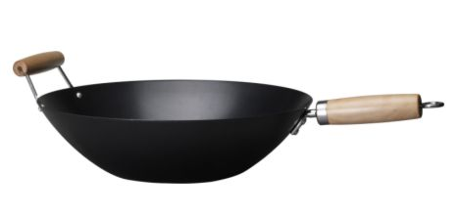
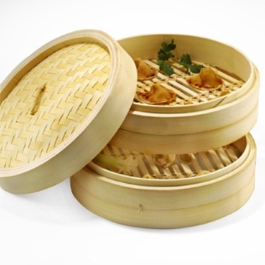
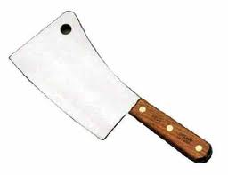
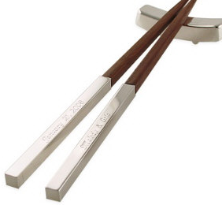
Cooking Utensils
Wok- large metal bowl with sloping sides, used for stir-fry
Steamer- Round shallow basket with openings, made of bamboo
Cleaver- used to cut food into small pieces easy to pick up with chop sticks
Chop sticks- eating utensil, made of bamboo or wood

Slide 11
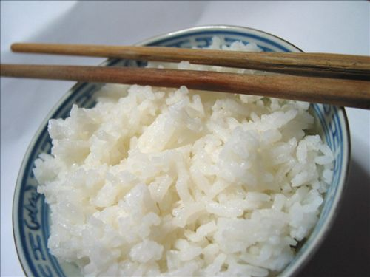
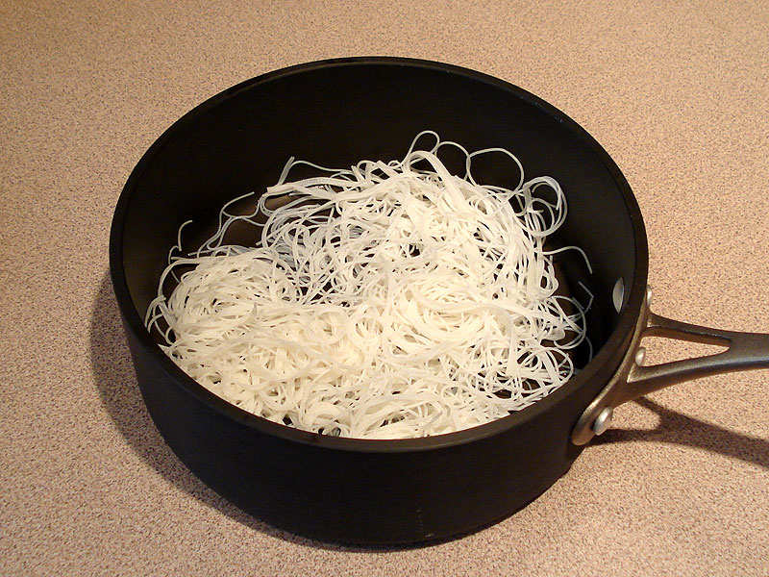
Rice
Rice is the backbone of southern Chinese diets
Rice is inexpensive and filling
They use short-grain rice to make flour and noodles.
Rice flour is used for pastries and dumplings

Slide 12
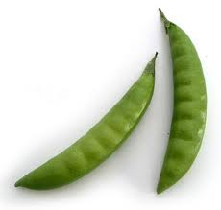
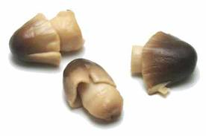
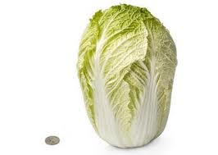
Vegetables
Vegetables are used more than meats in Chinese cooking
Used in dishes to stretch small amounts meat, poultry or fish
Makes Chinese cooking economical and nutritious.

Slide 13
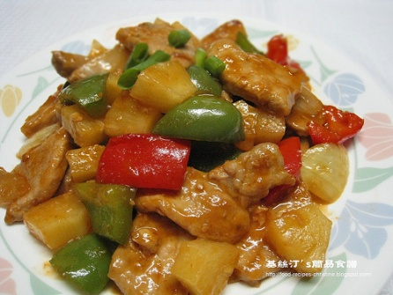
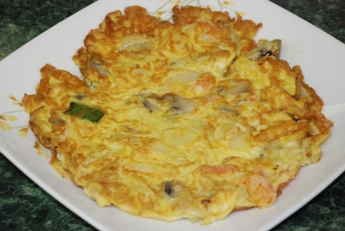
Chinese Main Dishes
Chicken and duck used often
Beef is usually not available and not very good
Pork can be used in fried rice or sweet and sour pork. A dish made of pork, pineapple, vegetables and sweet and sour sauce
Fish are most widely eaten due to coastline.
Eggs are considered good luck. Used in egg drop soup, fried rice, and egg foo yung.

Slide 14
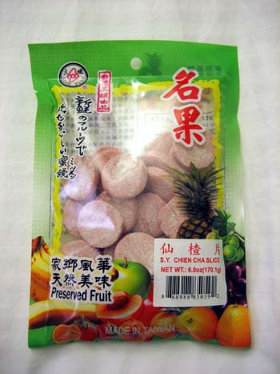
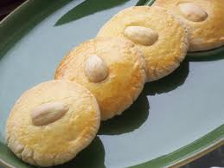
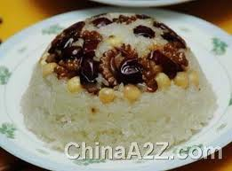
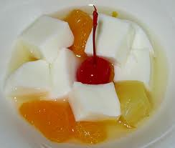
Desserts
Sweet desserts are not very common in China and reserved for special occasions.
Served in the middle of the meal if they do make dessert
Preserved fruit, almond cookies, almond float, eight treasure rice pudding are popular

Slide 15
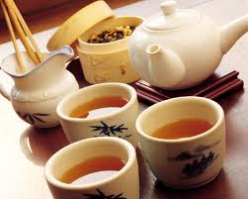
Tea
China’s national drink
Serve black teas, oolong teas and green teas.
They never add cream, lemon or sugar to tea
Usually served after a meal
Served to arriving and departing guests as a sign of hospitality.

Slide 16
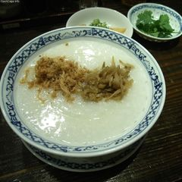
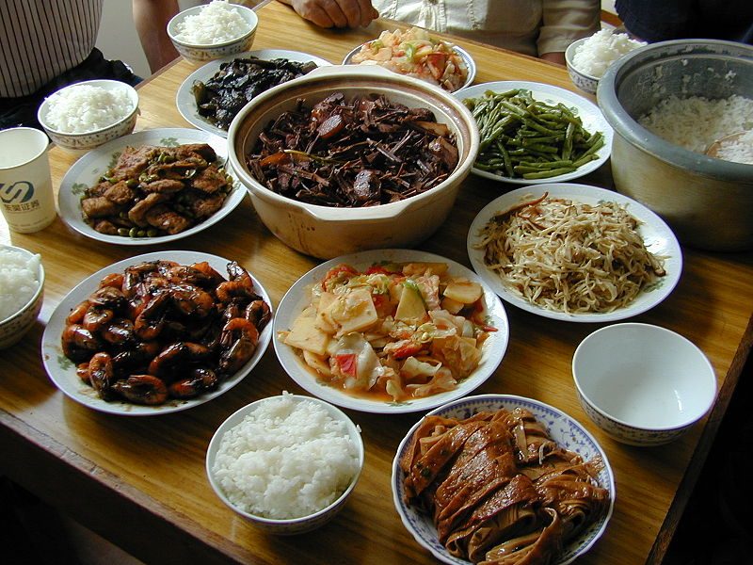
Meals
Breakfast: congee (a thick porridge made from rice or barley), rice, or boiled noodles.
Lunch & dinner: All dishes are served at once.
  Soup is in center of table, surrounded by four other main dishes
  Rice is always served

