Slide 1
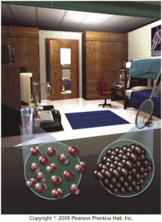
Unit 2
Matter and
Energy
Slides adapted from Nivaldo Tro

Slide 2
3.1 In Your Room
Everything you can see, touch, smell or taste in your room is made of matter.
Chemists study the differences in matter and how that relates to the structure of matter.

Slide 3
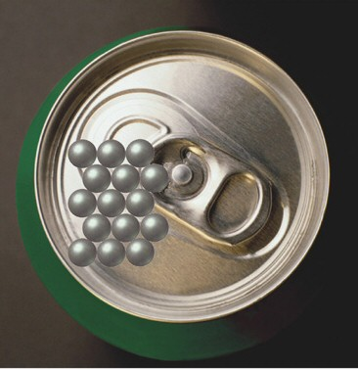
3.2 What is Matter?
Matter is defined as anything that occupies space and has mass
Even though it appears to be smooth and continuous, matter is actually composed of a lot of tiny little pieces we call atoms and molecules

Slide 4
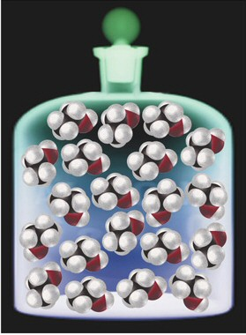
Atoms and Molecules
Atoms are the tiny particles that make up all matter.
In most substances, the atoms are joined together in units called molecules

Slide 5
Classifying Matter by Composition
matter that is composed of only one kind of piece is called a pure substance
matter that is composed of different kinds of pieces is called a mixture
because pure substances always have only one kind of piece, all samples show the same properties
however, because mixtures have variable composition, different samples will show different properties

Slide 6
Copper – a Pure Substance
color – brownish red
shiny, malleable and ductile
excellent conductor of heat and electricity
melting point = 1084.62°C
density = 8.96 g/cm³ at 20°C
Copper link

Slide 7
Brass – a Mixture
Type | Color | % Cu | % Zn | Density g/cm³ | MP °C | Tensile Strength psi | Uses
Gilding | reddish | 95 | 5 | 8.86 | 1066 | 50K | pre-83 pennies, munitions, plaques
Commercial | bronze | 90 | 10 | 8.80 | 1043 | 61K | door knobs, grillwork
Jewelry | bronze | 87.5 | 12.5 | 8.78 | 1035 | 66K | costume jewelry
Common | yellow | 67 | 33 | 8.42 | 940 | 70K | lamp fixtures, bead chain
Muntz metal | yellow | 60 | 40 | 8.39 | 904 | 70K | nuts & bolts,
Note the variable composition for this mixture.

Slide 8
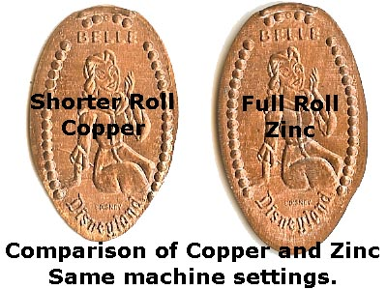
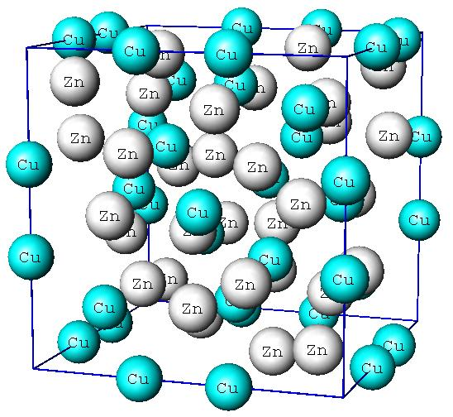
Brass

Slide 9
Classification of Matter
Matter
Pure Substance
Mixture
Constant Composition
Variable Composition
Homogeneous
Pure Substance = all samples are made of the same pieces in the same percentages
  salt
Mixtures = different samples may have the same pieces in different percentages
  salt water

Slide 10
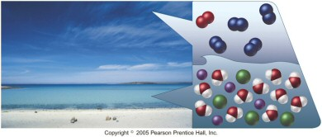
Classification of Mixtures
homogeneous = matter that is uniform throughout
  appears to be one thing
  every piece of a sample has identical properties, though another sample with the same components may have different properties
  solutions (homogeneous mixtures)
heterogeneous = matter that is non-uniform throughout
  contains regions with different properties than other regions

Slide 11
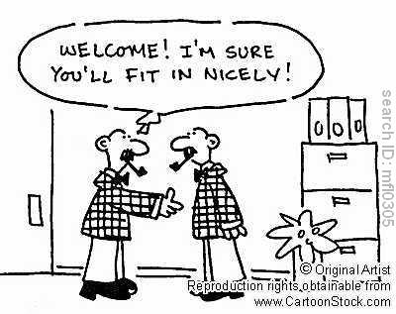
Homogeneous Mixtures
homogeneous = matter that is uniform throughout
  appears to be one thing
  every piece of a sample has identical properties, though another sample with the same components may have different properties
  solutions (homogeneous mixtures)

Slide 12
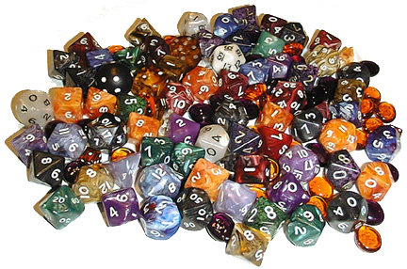
Heterogeneous
heterogeneous = matter that is non-uniform throughout
  contains regions with different properties than other regions

Slide 13
Pure Substances vs. Mixtures
Pure Substances
all samples have the same physical and chemical properties
constant composition = all samples have the same pieces in the same percentages
homogeneous
separate into components based on chemical properties
temperature usually stays constant while melting or boiling
Mixtures
different samples may show different properties
variable composition = samples made with the same pure substances may have different percentages
homogeneous or heterogeneous
separate into components based on physical properties
temperature changes while melting or boiling because composition changes

Slide 14
Classifying Pure Substances
Elements and Compounds
Substances which can not be broken down into simpler substances by chemical reactions are called elements
Most substances are chemical combinations of elements. These are called compounds.
  Compounds can be broken down into elements
  Properties of the compound not related to the properties of the elements that compose it

Slide 15
Atoms & Molecules
Smallest piece of an element is called an atom
  there are subatomic particles, but these are no longer the element
Smallest piece of a compound is called a molecule
  molecules are made of atoms
  all molecules of a compound are identical
  each molecule has the same number and type of atoms

Slide 16
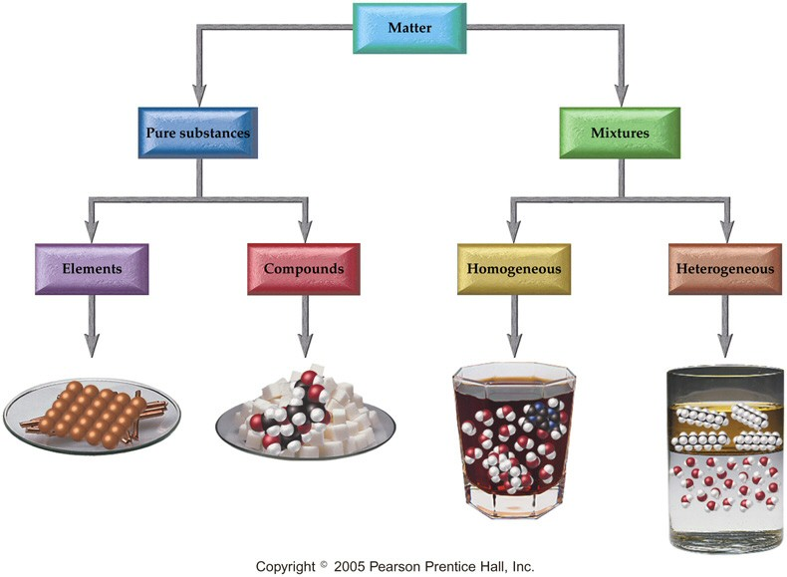
Classifying Matter

Slide 17
Elements
116 known, of which about 91 are found in nature
  others are man-made
Abundance = percentage found in nature
  oxygen most abundant element (by mass) on earth and in the human body
the abundance and form of an element varies in different parts of the environment
every sample of an element is made up of lots of identical atoms

Slide 18
Compounds
composed of elements in fixed percentages
  water is 89% O & 11% H
billions of known compounds
organic or inorganic
same elements can form more than one different compound
  water and hydrogen peroxide contain just hydrogen and oxygen
  carbohydrates all contain just C, H & O

Slide 19
3.3 Classifying Matter by Physical State
matter can be classified as solid, liquid or gas based on what properties it exhibits
Fixed = keeps shape when placed in a container,
Indefinite = takes the shape of the container

Slide 20
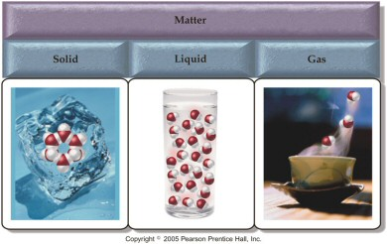
Structure Determines Properties
the atoms or molecules have different structures in solids, liquid and gases, leading to different properties

Slide 21
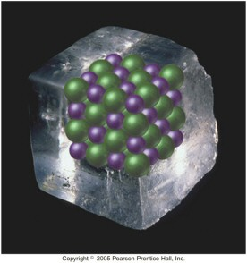
Solids
the particles in a solid are packed close together and are fixed in position
  though they may vibrate
the close packing of the particles results in solids being incompressible
the inability of the particles to move around results in solids retaining their shape and volume when placed in a new container; and prevents the particles from flowing

Slide 22
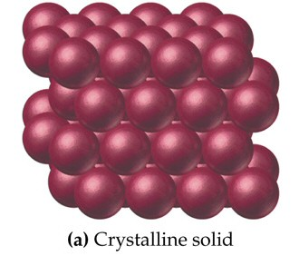
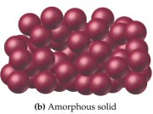
Solids
some solids have their particles arranged in an orderly geometric pattern – we call these crystalline solids
  salt and diamonds
other solids have particles that do not show a regular geometric pattern over a long range – we call these amorphous solids
  plastic and glass

Slide 23
Liquids
the particles in a liquid are closely packed, but they have some ability to move around
the close packing results in liquids being incompressible
but the ability of the particles to move allows liquids to take the shape of their container and to flow – however they don’t have enough freedom to escape and expand to fill the container

Slide 24
Gases
in the gas state, the particles have complete freedom from each other
the particles are constantly flying around, bumping into each other and the container
in the gas state, there is a lot of empty space between the particles
  on average

Slide 25
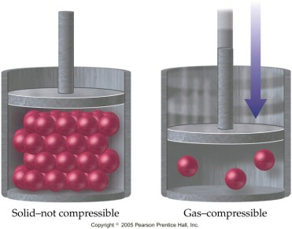
Gases
because there is a lot of empty space, the particles can be squeezed closer together – therefore gases are compressible
because the particles are not held in close contact and are moving freely, gases expand to fill and take the shape of their container, and will flow

Slide 26
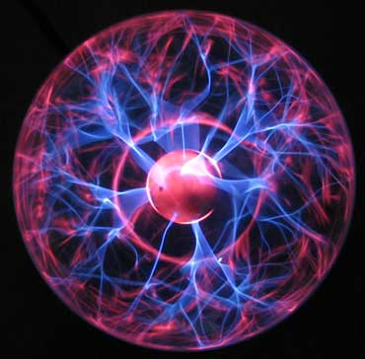
Plasma
Considered to be the fourth state of matter
Makes up 99% of our visible universe
Very good conductors

Slide 27
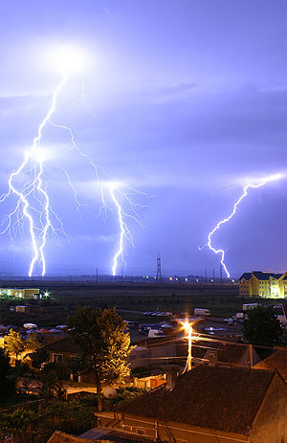
Plasma
Lightning at the earths surface is an example of plasma

Slide 28
Video
States of Matter Video

Slide 29
Properties of Matter
Physical Properties are the characteristics of matter that can be observed without changing its composition
  characteristics that are directly observable
Chemical Properties are the characteristics that determine how the composition of matter changes as a result of contact with other matter or the influence of energy
  characteristics that describe the behavior of matter

Slide 30
Some Physical Properties

Slide 31
Some Chemical Properties

Slide 32
Some Physical Properties of Iron
iron is a silvery solid at room temperature with a metallic taste and smooth texture
iron melts at 1538°C and boils at 4428°C
iron’s density is 7.87 g/cm³
iron can be magnetized
iron conducts electricity, but not as well as most other common metals
iron’s ductility and thermal conductivity are about average for a metal
it requires 0.45 J of heat energy to raise the temperature of one gram of iron by 1°C

Slide 33
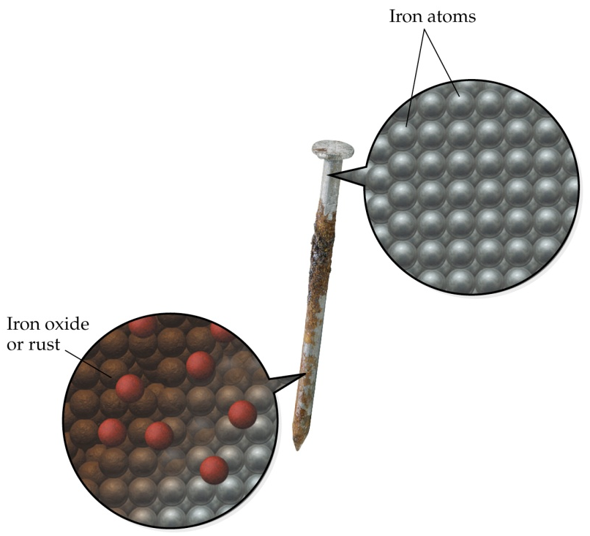
Some Chemical Properties of Iron
iron is easily oxidized in moist air to form rust
when iron is added to hydrochloric acid, it produces a solution of ferric chloride and hydrogen gas
iron is more reactive than silver, but less reactive than magnesium

Slide 34
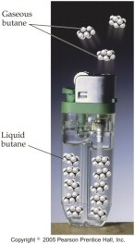
Changes in Matter
Physical Changes - changes in the properties of matter that do not effect its composition
  Heating water
    raises its temperature, but it is still water
  Evaporating butane from a lighter
  Dissolving sugar in water
    even though the sugar seems to disappear, it can easily be separated back into sugar and water by evaporation

Slide 35
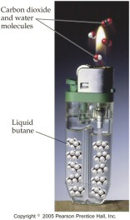
Changes in Matter
Chemical Changes involve a change in the properties of matter that change its composition
  a Chemical Reaction
  rusting is iron combining with oxygen to make iron(III) oxide
  burning butane from a lighter changes it into carbon dioxide and water
  silver combines with sulfur in the air to make tarnish

Slide 36
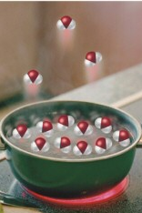
Phase Changes are
Physical Changes
Boiling = liquid to gas
Melting = solid to liquid
Subliming = solid to gas
Condensing = gas to liquid
Freezing = liquid to solid
Deposition = gas to solid
state changes require heating or
cooling the substance

Slide 37
Separation of Mixtures
Separate mixtures based on different physical properties of the components
  Physical change
Different Physical Property
Technique
Boiling Point
Distillation
State of Matter (solid/liquid/gas)
Filtration
Adherence to a Surface
Chromatography
Volatility
Evaporation
Density
Centrifugation &
Decanting

Slide 38
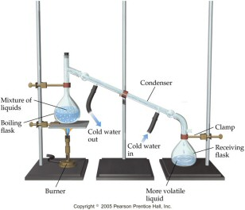
Distillation

Slide 39
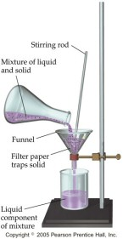
Filtration

Slide 40
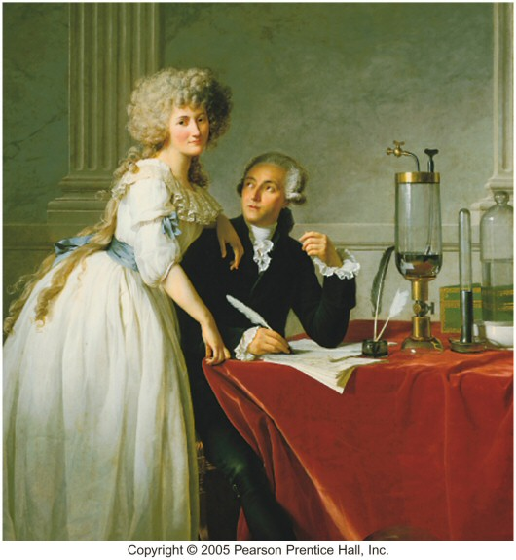
Law of Conservation of Mass
Antoine Lavoisier
“Matter is neither created nor destroyed in a chemical reaction”
the total amount of matter present before a chemical reaction is always the same as the total amount after
the total mass of all the reactants is equal to the total mass of all the products

Slide 41
Conservation of Mass
Total amount of matter remains constant in a chemical reaction
58 grams of butane burns in 208 grams of oxygen to form 176 grams of carbon dioxide and 90 grams of water.
butane + oxygen → carbon dioxide + water
58 grams + 208 grams → 176 grams + 90 grams
266 grams = 266 grams

Slide 42

Density
http://www.youtube.com/watch?v=5QWXLZ91DUM&feature=related

Slide 43
Mass & Volume
two main characteristics of matter
cannot be used to identify what type of matter something is
  if you are given a large glass containing 100 g of a clear, colorless liquid and a small glass containing 25 g of a clear, colorless liquid - are both liquids the same stuff?
even though mass and volume are individual properties - for a given type of matter they are related to each other!

Slide 44
Mass vs Volume of Brass

Slide 45
Volume vs Mass of Brass
y = 8.38x
160
140
120
100
Mass, g
80
60
40
20
0
0.0
2.0
4.0
6.0
8.0
10.0
12.0
14.0
16.0
18.0
Volume, cm3

Slide 46
Density
Ratio of mass:volume
Solids = g/cm³
  1 cm³ = 1 mL
Liquids = g/mL
Gases = g/L
Volume of a solid can be determined by water displacement – Archimedes Principle
Density : solids > liquids >>> gases
  except ice is less dense than liquid water!

Slide 47
Density
For equal volumes, denser object has larger mass
For equal masses, denser object has smaller volume
Heating objects causes objects to expand
  does not effect their mass!!
  How would heating an object effect its density?
In a heterogeneous mixture, the denser object sinks
  Why do hot air balloons rise?

Slide 48
Using Density in Calculations
Solution Maps:
m, V
D
m, D
V
V, D
m

Slide 49
Platinum has become a popular metal for fine jewelry. A man gives a woman an engagement ring and tells her that it is made of platinum. Noting that the ring felt a little light, the woman decides to perform a test to determine the ring’s density before giving him an answer about marriage. She places the ring on a balance and finds it has a mass of 5.84 grams. She then finds that the ring displaces 0.556 cm³ of water. Is the ring made of platinum? (Density Pt = 21.4 g/cm³)

Slide 50
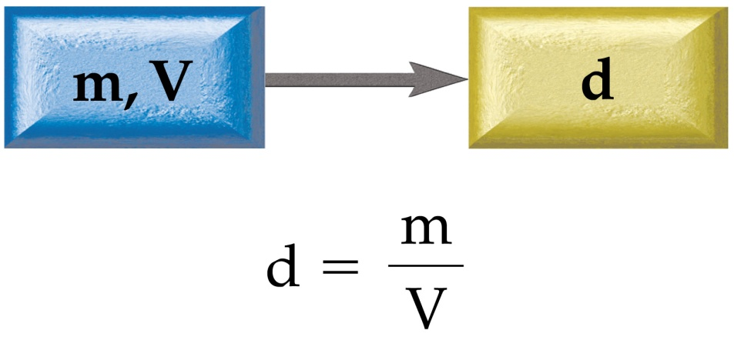
She places the ring on a balance and finds it has a mass of 5.84 grams. She then finds that the ring displaces 0.556 cm³ of water. Is the ring made of platinum? (Density Pt = 21.4 g/cm³)
Given: Mass = 5.84 grams
Volume = 0.556 cm³
Find: Density in grams/cm³
Equation:
Solution Map:
m and V → d

Slide 51
She places the ring on a balance and finds it has a mass of 5.84 grams. She then finds that the ring displaces 0.556 cm³ of water. Is the ring made of platinum? (Density Pt = 21.4 g/cm³)
Apply the Solution Map:
Since 10.5 g/cm³ ≠ 21.4 g/cm³ the ring cannot be platinum

Slide 52
Density as a Conversion Factor
can use density as a conversion factor between mass and volume!!
  density of H₂O = 1 g/mL ∴ 1 g H₂O = 1 mL H₂O
  density of Pb = 11.3 g/cm³ ∴ 11.3 g Pb = 1 cm³ Pb
How much does 4.0 cm³ of Lead weigh?
11.3 g Pb
1 cm³ Pb
4.0 cm³ Pb
x
=
45 g Pb

Slide 53
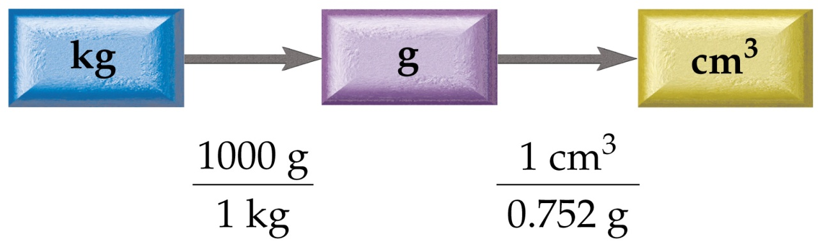
Measurement and Problem Solving
Density as a Conversion Factor
The gasoline in an automobile gas tank has a mass of 60.0 kg and a density of 0.752 g/cm³. What is the volume?
Given: 60.0 kg
Find: Volume in L
Conversion Factors:
  0.752 grams/cm³
  1000 grams = 1 kg

Slide 54
Measurement and Problem Solving
Density as a Conversion Factor
Solution Map: kg → g → cm³

Slide 55
Example 2.16: Density as a Conversion Factor

Slide 56
Example:
A 55.9 kg person displaces 57.2 L of water when submerged in a water tank. What is the density of the person in g/cm³?

Slide 57
Example:
A 55.9 kg person displaces 57.2 L of water when submerged in a water tank. What is the density of the person in g/cm³?
Write down the given quantity and its units.
Given: m = 55.9 kg
  V = 57.2 L

Slide 58
Example:
A 55.9 kg person displaces 57.2 L of water when submerged in a water tank. What is the density of the person in g/cm³?
Information
Given: m = 55.9 kg
V = 57.2 L
Write down the quantity to find and/or its units.
  Find: density, g/cm³

Slide 59
Example:
A 55.9 kg person displaces 57.2 L of water when submerged in a water tank. What is the density of the person in g/cm³?
Information:
Given: m = 55.9 kg
V = 57.2 L
Find: density, g/cm³
Design a Solution Map:
m, V D

Slide 60
Example:
A 55.9 kg person displaces 57.2 L of water when submerged in a water tank. What is the density of the person in g/cm³?
Information:
Given: m = 55.9 kg
V = 57.2 L
Find: density, g/cm³
Equation:
Collect Needed Conversion Factors:
  Mass: 1 kg = 1000 g
  Volume: 1 mL = 0.001 L; 1 mL = 1 cm³

Slide 61
Example:
A 55.9 kg person displaces 57.2 L of water when submerged in a water tank. What is the density of the person in g/cm³?
Information:
Given: m = 55.9 kg
V = 57.2 L
Find: density, g/cm³
Solution Map: m,V→D
Equation:
Conversion Factors: 1 kg = 1000 g
1 mL = 0.001 L
1 mL = 1 cm³
Write a Solution Map for converting the Mass units
Write a Solution Map for converting the Volume units
kg
g
L
mL
cm³

Slide 62
Example:
A 55.9 kg person displaces 57.2 L of water when submerged in a water tank. What is the density of the person in g/cm³?
Information:
Given: m = 55.9 kg
V = 57.2 L
Find: density, g/cm³
Solution Map: m,V→D
Equation:
Apply the Solution Maps
= 5.59 x 10⁴ g

Slide 63
Example:
A 55.9 kg person displaces 57.2 L of water when submerged in a water tank. What is the density of the person in g/cm³?
Information:
Given: m = 5.59 x 10⁴ g
V = 57.2 L
Find: density, g/cm³
Solution Map: m,V→D
Equation:
Apply the Solution Maps
= 5.72 x 10⁴ cm³

Slide 64
Example:
A 55.9 kg person displaces 57.2 L of water when submerged in a water tank. What is the density of the person in g/cm³?
Information:
Given: m = 5.59 x 10⁴ g
V = 5.72 x 10⁴ cm³
Find: density, g/cm³
Solution Map: m,V→D
Equation:
Apply the Solution Maps - Equation
= 0.9772727 g/cm³
= 0.977 g/cm³

Slide 65
Example:
A 55.9 kg person displaces 57.2 L of water when submerged in a water tank. What is the density of the person in g/cm³?
Information:
Given: m = 5.59 x 10⁴ g
V = 5.72 x 10⁴ cm³
Find: density, g/cm³
Solution Map: m,V→D
Equation:
Check the Solution
D = 0.977 g/cm³
The units of the answer, g/cm³, are correct.
The magnitude of the answer makes sense.
Since the mass in kg and volume in L are
very close in magnitude, the answer’s
magnitude should be close to 1.

Slide 66
Energy
there are things that do not have mass and volume
these things fall into a category we call Energy
Energy is anything that has the capacity to do work
even though Chemistry is the study of matter, matter is effected by energy
  it can cause physical and/or chemical changes in matter

Slide 67
Law of Conservation of Energy
“Energy can neither be created nor destroyed”
the total amount of energy in the universe is constant – there is no process that can increase or decrease that amount
however we can transfer energy from one place in the universe to another, and we can change its form

Slide 68
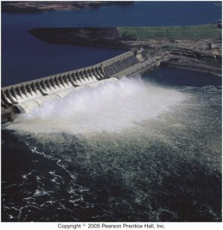
Kinds of Energy
Kinetic and Potential
Kinetic Energy is energy of motion, or energy that is being transferred from one object to another
Potential Energy is energy that is stored

Slide 69
Some Forms of Energy
Electrical
  kinetic energy associated with the flow of electrical charge
Heat or Thermal Energy
  kinetic energy associated with molecular motion
Light or Radiant Energy
  kinetic energy associated with energy transitions in an atom
Nuclear
  potential energy in the nucleus of atoms
Chemical
  potential energy in the attachment of atoms or because of their position

Slide 70
Units of Energy
calorie (cal) is the amount of energy needed to raise one gram of water by 1°C
  kcal = energy needed to raise 1000 g of water 1°C
  food Calories = kcals
Energy Conversion Factors
1 calorie (cal) | = | 4.184 joules (J)
1 Calorie (Cal) | = | 1000 calories (cal)
1 kilowatt-hour (kWh) | = | 3.60 x 10⁶ joules (J)

Slide 71
The Meaning of Heat
Heat is the exchange of thermal energy between samples of matter
heat flows from the matter that has high thermal energy to matter that has low thermal energy
  until …
heat is exchanged through molecular collisions between two samples

Slide 72
The Meaning of Temperature
Temperature is a measure of the average kinetic energy of the molecules in a sample
Not all molecules in a sample have the same amount of kinetic energy
higher temperature means a larger average kinetic energy

Slide 73
Temperature Scales
100°C
373 K
212°F
BP Water
25°C
298 K
75°F
Room Temp
0°C
273 K
32°F
MP Ice
-38.9°C
234.1 K
-38°F
BP Mercury
-183°C
90 K
-297°F
BP Oxygen
-269°C
4 K
-452°F
BP Helium
-273°C
0 K
-459 °F
Absolute
Zero
Celsius
Kelvin
Fahrenheit

Slide 74
Fahrenheit vs. Celsius
a Celsius degree is 1.8 times larger than a Fahrenheit degree
the standard used for 0° on the Fahrenheit scale is a lower temperature than the standard used for 0° on the Celsius scale

Slide 75
The Kelvin Temperature Scale
both the Celsius and Fahrenheit scales have negative numbers
  but real physical things are always positive amounts!
the Kelvin scale is an absolute scale, meaning it measures the actual temperature of an object
0 K is called Absolute Zero. It is too cold for matter to exist at because all molecular motion would stop
  0 K = -273°C = -459°F
  Absolute Zero is a theoretical value obtained by following patterns mathematically

Slide 76
Kelvin vs. Celsius
the size of a “degree” on the Kelvin scale is the same as on the Celsius scale
  we don’t call the divisions on the Kelvin scale degrees; we called them kelvins!
  But the Kelvin scale starts at a much lower temperature – absolute zero

Slide 77
Energy and the Temperature of Matter
Increase in temperature of an object depends on the amount of heat added (q).
  If you double the added heat energy the temperature will increase twice as much.
Increase in temperature of an object ALSO depends on its mass (m)
  If you double the mass it will take twice as much heat energy to raise the temperature the same amount.

Slide 78
Heat Capacity
heat capacity is the amount of heat a substance must absorb to raise its temperature 1°C
  cal/°C or J/°C
  metals have low heat capacities, insulators high
specific heat = heat capacity of 1 gram of the substance
  cal/g°C or J/g°C
  waters specific heat = 4.184 J/g°C for liquid
    or 1.000 cal/g°C
    less for ice and steam

Slide 79
Specific Heat Capacity
Specific Heat is the amount of energy required to raise the temperature of one gram of a substance by one Celsius degree
the larger a material’s specific heat is, the more energy it takes to raise its temperature a given amount
like density, specific heat is a property of the type of matter
  it doesn’t matter how much material you have
  it can be used to identify the type of matter
water’s high specific heat is the reason it is such a good cooling agent
  it absorbs a lot of heat for a relatively small mass

Slide 80
Specific Heat Capacities

Slide 81
Heat Gain or Loss by an Object
the amount of heat energy gained or lost by an object depends on 3 factors – how much material there is, what the material is, and how much the temperature changed
Amount of Heat = Mass x Heat Capacity x Temperature Change
q = m x C x ΔT

Slide 82
Example:
How much heat must 2.5 g of gallium absorb from your hand to raise its temperature from 25.0°C to 29.9°C? The heat capacity of gallium is 0.372 J/g°C

Slide 83
Example:
If the temperature of 28 g of ethanol increases from 15°C to 65.5°C, how much heat was absorbed by the ethanol? (Specific heat ethanol = 2.44 J/g°C)

Slide 84
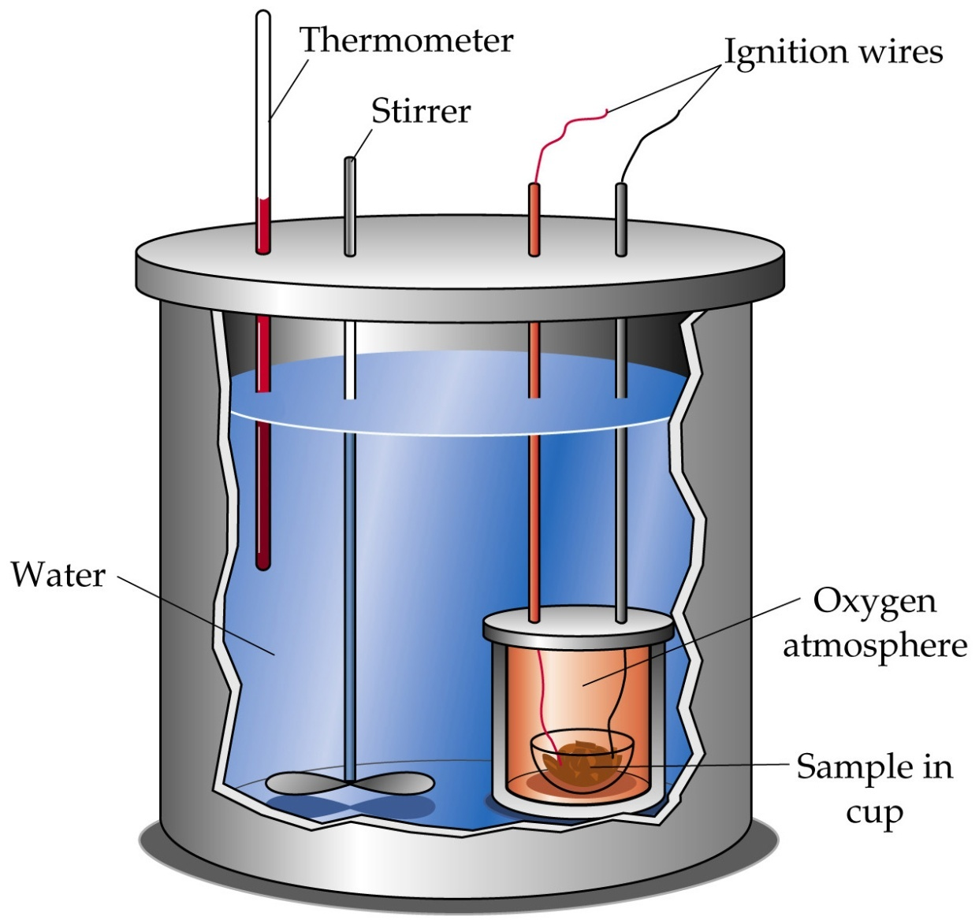
Bomb Calorimeter

Slide 85
Video
Specific Heat
Specific Heat Video

