Slide 1
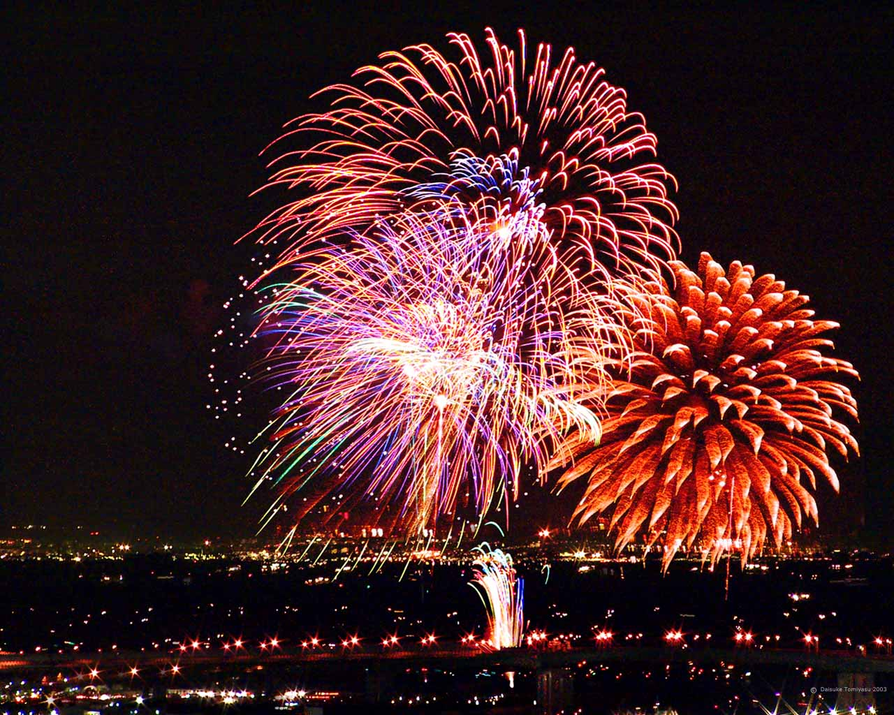
Introduction to Chemical Equations
and Chemical Reactions

Slide 2
Law of Conservation of Matter
Matter can NOT be created or destroyed, but it can be rearranged.
It is the rearrangements of matter that we observe during chemical reactions

Slide 3
How do we know when a reaction is happening?
Color Change
Gas Produced
Change in Temperature
Solid materials form
Flame Occurs

Slide 4
EVERY Chemical Reaction can be Described by an Equation
An equation shows reactants and products.
Start a reaction
Result of a reaction

Slide 5

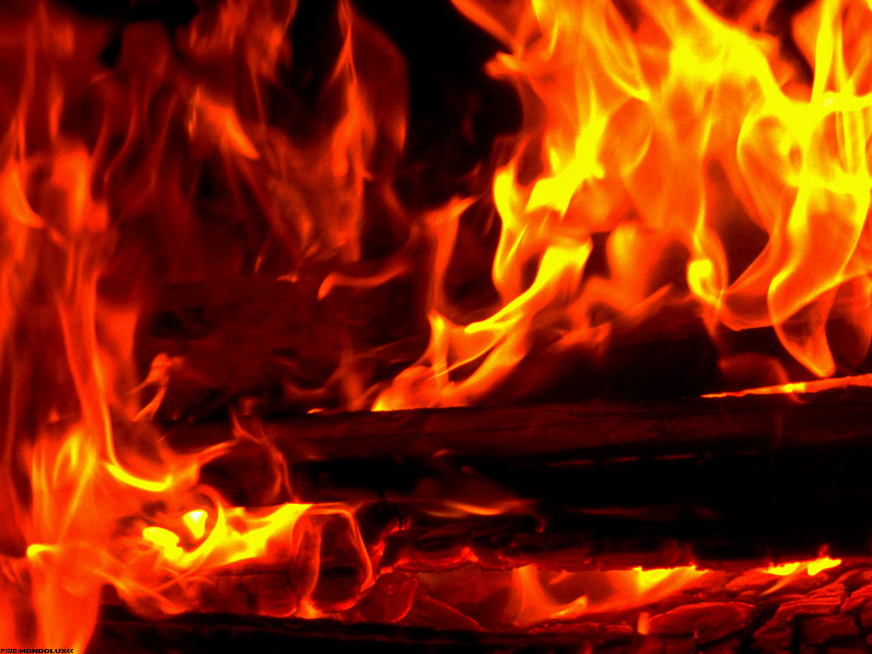
When wood burns...
A chemical reaction is happening!
Matter is being rearranged, but NO mass is lost.
If you were to collect all of the products and measure their mass, it would be equal to the original mass of the wood.
Mass of Reactants = Mass of Products
(Law of Conservation of Matter)

Slide 6
Every Equation MUST be “Balanced”
By “balancing” an equation, we are satisfying the Law of Conservation of Matter.
“Balancing” means that there are the SAME number and type of EACH atom on both sides of the equation.

Slide 7
Look at the Following Equation:
CH4 + O2 ------> CO2 + H2O
Count the number of each type of atom on both sides of the equation. Do these numbers agree?

Slide 8
Here’s the Count
CH4 + O2 ------> CO2 + H2O
1 - carbon
4 - hydrogen
2 - oxygen
1 - carbon
2 - hydrogen
3 - oxygen
This equation is NOT “balanced”

Slide 9
To Balance an Equation we need to add Coefficients
Coefficients appear in front of a reactant or product in an equation
Coefficients change the ratio between reactants and products

Slide 10
How it Works:
CH4 + 2O2 ------> CO2 + 2H2O
1 - carbon
4 - hydrogen
4 - oxygen
1 - carbon
4 - hydrogen
4 - oxygen
This equation is NOW “balanced”

Slide 11
Balancing is Trial and Error!!
You must play around with coefficients until the equation is balanced.
You may NOT change any subscripts in any of the reactant’s or product’s formulas
Use the smallest set of coefficients that will work correctly.

Slide 12
USE These Rules
Balance the non Oxygen and Hydrogen elements
Balance the Hydrogen
Balance the Oxygen
Check all the atoms
If needed increase the first non Oxygen/Hydrogen element coefficient by one
Repeat

Slide 13
DO these:
__ K + __ H2O ------> __ KOH + __ H2
2 K + 2 H2O ------> 2 KOH + __ H2
__ KBr + __ H3PO4 ----> __ K3PO4 + __ HBr
3 KBr + __ H3PO4 ----> __ K3PO4 + 3 HBr
Remember, a blank means “1”

Slide 14
CHALLENGE!
__ NH3 + __ O2 -------> __ NO + __ H2O
4 NH3 + 5 O2 -------> 4 NO + 6 H2O

Slide 15
Bonus:
__C3H5(NO3)3 -----> __ CO2 + __ H2O + __ N2 + __ O2

