Slide 1
Acids and Bases
Solutions of Chemical Energy

Slide 2
What is an Acid?
A substance that dissociates and produces H⁺ (protons) when in solution
Examples: (strong acids)
HCl, H₂SO₄, HNO₃

Slide 3
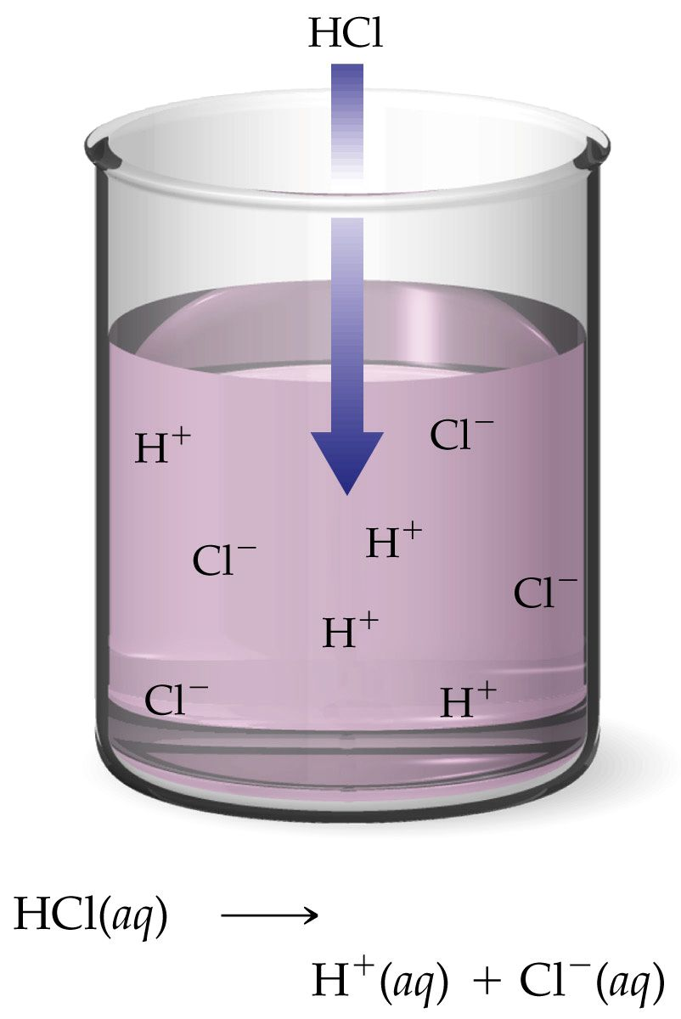
Dissociation of HCl
HCl_{(aq)} -> H⁺_{(aq)} + Cl⁻_{(aq)}
Each mole of HCl will produce 1 mole of H⁺
What is different about H₂SO₄?

Slide 4
What is a Base?
A base is any substance that dissociates to produce OH⁻ (hydroxide ions) in solution
Examples: (strong bases)
NaOH, LiOH, KOH

Slide 5
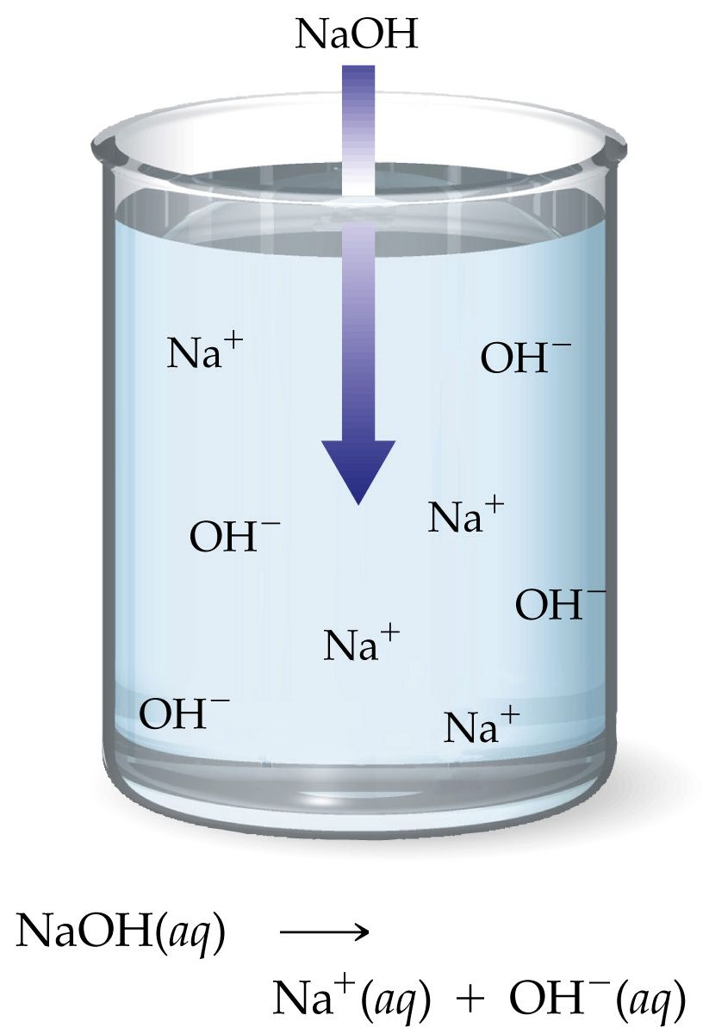
Dissociation of NaOH
NaOH_{(aq)} -> Na⁺_{(aq)} + OH⁻_{(aq)}
Each mole of NaOH will dissociate to produce 1 mole of OH⁻

Slide 6
Neutralization Reactions:
A type of double-replacement reaction that produces a “salt” and water from an acid and base
HCl + NaOH ----> NaCl + H₂O
Acid + Base ----> Salt + Water

Slide 7
Characteristics of Acids and Bases:
Bases Taste Bitter
(Soap)
Acids Taste Sour
(Sour Patch Kids, Lemons, Vinegar)

Slide 8
Weak Acids and Bases
Do not completely dissociate
Are still dangerous energetic solutions
More common in nature
Acetic Acid (vinegar)
Citric Acid (lemon jucie)
Found in buffered solutions
Have pHs closer to 7 at higher solution concentrations

Slide 9
pH Scale
(Concentration of H⁺ ions)
A pH of 7.0 is “neutral”
A pH >7.0 is “basic”
(The farther from neutral, the stronger the base)
A pH <7.0 is “acidic”
(The farther from neutral, the stronger the acid)

Slide 10
Math of pH
-log(H⁺ concentration in moles/Liter)
Eg. 1.00 X 10⁻⁷ M, The pH is 7
Eg. 1.00 X 10⁻¹M, The pH is 1
Eg. 1.00 X 10⁻¹⁴M, The pH is 14

Slide 11
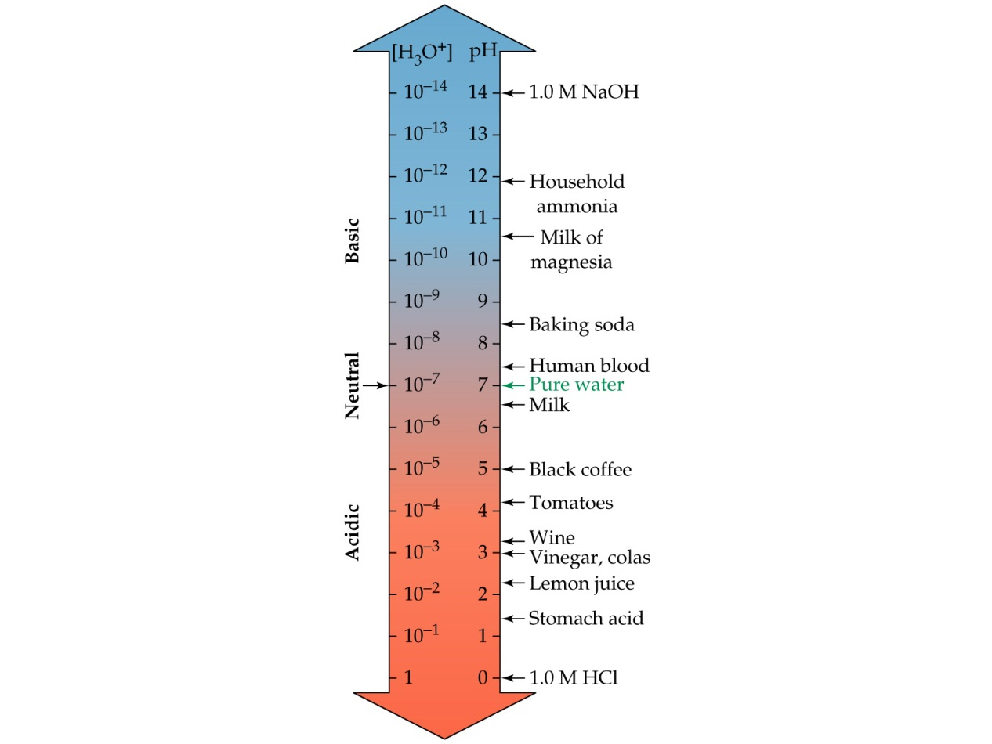
Strength of Acids and Bases
Measured on the pH Scale
Range from 1-14

Slide 12
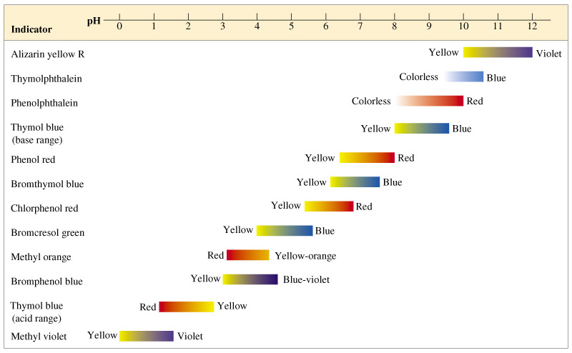
pH Indicators

Slide 13
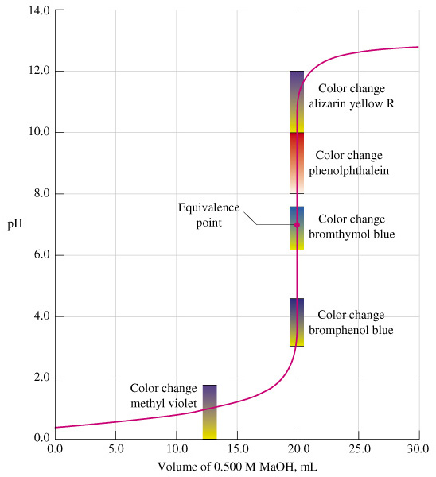
Each Indicator Changes at a Certain pH Range
Indicators are helpful when performing Titrations

Slide 14
Buffered solutions
Resist forming more H⁺ or OH⁻ ions
Made from a weak acid and a salt
Very important to life (Blood is 7.35 – 7.45 pH)

Slide 15
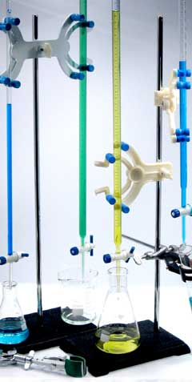
Equipment for Titrations:
Used to measure unknown pH by comparison to a known
Burets are used to measure highly accurate volumes of solutions

